Slide 1
Job assignment using branch and bound
RNS INSTITUTE OF TECHNOLOGY
BENGALURU - 98
DEPARTMENT OF INFORMATION SCIENCE & ENGINEERING
DAA Mini Project Work Presentation
Candidate Names
USN 1: 1RN20IS105 Phalguni G Prasad
USN 2: 1RN20IS107 Prajna S G
USN 3: 1RN20IS108 Prajwal B P Barlaya
USN 4: 1RN20IS075 Keerthana M J
Faculty Incharge
Ms.Kusuma S
Prof./Asst. Prof
Dept of ISE, RNSIT

Slide 2
AGENDA
Abstract
Introduction
Algorithm Design Technique Used
Algorithm
System Requirements
Implementation/Code
Discussion of Results-Sample input and Output
Time Complexity: Analysis of algorithm with other related algorithms
Real time Applications

Slide 3
ABSTRACT
The assignment problem is a fundamental optimization problem. In its most general form, the problem is as follows:The problem instance has a number of agents and a number of tasks. Any agent can be assigned to perform any task, incurring some cost that may vary depending on the agent-task assignment. It is required to perform as many tasks as possible by assigning at most one agent to each task and at most one task to each agent, in such a way that the total cost of the assignment is minimized.

Slide 4
INTRODUCTION
Branch and Bound
Branch and bound is an algorithm design paradigm which is generally used for solving combinatorial optimization problems.
These problems are typically exponential in terms of time complexity and may require exploring all possible permutations in worst case.
The Branch and Bound Algorithm technique solves these problems relatively quickly.
Few problems like 0/1 knapsack , travelling sales person , job assignment can be solved using branch and bound.

Slide 5
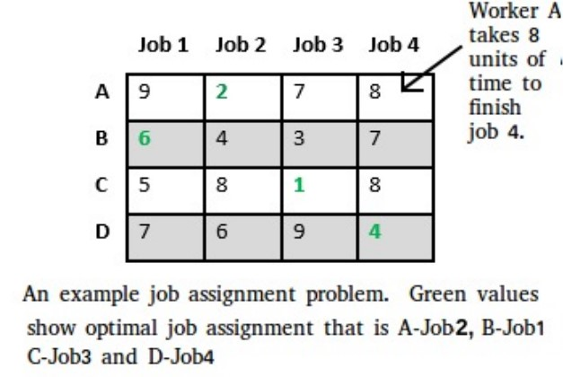
Job Assignment using Branch and Bound
Problem statement-Let there be N workers and N jobs. Any worker can be assigned to perform any job, incurring some cost that may vary depending on the work-job assignment. It is required to perform all jobs by assigning exactly one worker to each job and exactly one job to each agent in such a way that the total cost of the assignment is minimized.

Slide 6
Algorithm
/* findMinCost uses Least() and Add() to maintain the list of live nodes
Least() finds a live node with least cost, deletes it from the list and returns it
Add(x) calculates cost of x and adds it to the list of live nodes
Implements list of live nodes as a min heap */
// Search Space Tree Node
node
{
int job_number;
int worker_number;
node parent;
int cost;
}
// Input: Cost Matrix of Job Assignment problem
// Output: Optimal cost and Assignment of Jobs

Slide 7
Algorithm findMinCost (costMatrix mat[][])
{
// Initialize list of live nodes(min-Heap)
// with root of search tree i.e. a Dummy node
while (true)
{
// Find a live node with least estimated cost
E = Least();
// The found node is deleted from the list of live nodes
if (E is a leaf node)
{ printSolution();
return;
}
for each child x of E
{ Add(x); // Add x to list of live nodes;
x->parent = E; // Pointer for path to root
}
}
}

Slide 8
Implementation / Coding in c++
// Program to solve Job Assignment problem
// using Branch and Bound
#include <bits/stdc++.h>
using namespace std;
#define N 4
// state space tree node
struct Node
{
// stores parent node of current node
// helps in tracing path when answer is found
Node* parent;
// contains cost for ancestors nodes
// including current node
int pathCost;
// contains least promising cost
int cost;
// contain worker number
int workerID;
// contains Job ID
int jobID;
// Boolean array assigned will contains
// info about available jobs
bool assigned[N];
};
// Function to allocate a new search tree node
// Here Person x is assigned to job y
Node* newNode(int x, int y, bool assigned[],
Node* parent)

Slide 9
{
Node* node = new Node;
for (int j = 0; j < N; j++)
node->assigned[j] = assigned[j];
node->assigned[y] = true;
node->parent = parent;
node->workerID = x;
node->jobID = y;
return node;
}
// Function to calculate the least promising cost
// of node after worker x is assigned to job y.
int calculateCost(int costMatrix[N][N], int x,
int y, bool assigned[])
{
int cost = 0;
// to store unavailable jobs
bool available[N] = {true};
for (int i = x + 1; i < N; i++)
{
int min = INT_MAX, minIndex = -1;
// do for each job
for (int j = 0; j < N; j++)
{
// if job is unassigned
if (!assigned[j] && available[j] &&
costMatrix[i][j] < min)
{
// store job number
minIndex = j;
// store cost
min = costMatrix[i][j];
}
}

Slide 10
// add cost of next worker
cost += min;
// job becomes unavailable
available[minIndex] = false;
}
return cost;
}
// Comparison object to be used to order the heap
struct comp
{
bool operator()(const Node* lhs,
const Node* rhs) const
{
return lhs->cost > rhs->cost;
}
};
// print Assignments
void printAssignments(Node *min)
{
if(min->parent==NULL)
return;
printAssignments(min->parent);
cout << "Assign Worker " << char(min->workerID + 'A')
<< " to Job " << min->jobID << endl;
}
// Finds minimum cost using Branch and Bound.
int findMinCost(int costMatrix[N][N])
{
// Create a priority queue to store live nodes of
// search tree;
priority_queue<Node*, std::vector<Node*>, comp> pq;

Slide 11
// initialize heap to dummy node with cost 0
bool assigned[N] = {false};
Node* root = newNode(-1, -1, assigned, NULL);
root->pathCost = root->cost = 0;
root->workerID = -1;
// Add dummy node to list of live nodes;
pq.push(root);
while (!pq.empty())
{
// Find a live node with least estimated cost
Node* min = pq.top();
// The found node is deleted from the list of
// live nodes
pq.pop();
// i stores next worker
int i = min->workerID + 1;
// if all workers are assigned a job
if (i == N)
{
printAssignments(min);
return min->cost;
}
// do for each job
for (int j = 0; j < N; j++)
{
// If unassigned
if (!min->assigned[j])
{
// create a new tree node
Node* child = newNode(i, j, min->assigned, min);
// cost for ancestors nodes including current node
child->pathCost = min->pathCost + costMatrix[i][j];

Slide 12
// calculate its lower bound
child->cost = child->pathCost +
calculateCost(costMatrix, i, j, child->assigned);
// Add child to list of live nodes;
pq.push(child);
}
}
}
}
// Driver code
int main()
{
// x-coordinate represents a Worker
// y-coordinate represents a Job
int costMatrix[N][N] =
{
{9, 2, 7, 8},
{6, 4, 3, 7},
{5, 8, 1, 8},
{7, 6, 9, 4}
};
cout << "\nOptimal Cost is "
<< findMinCost(costMatrix);
return 0;
}

Slide 13
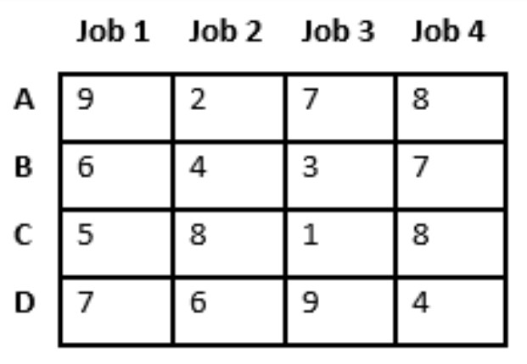
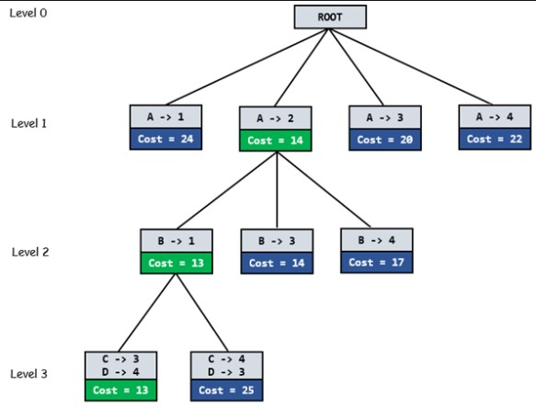
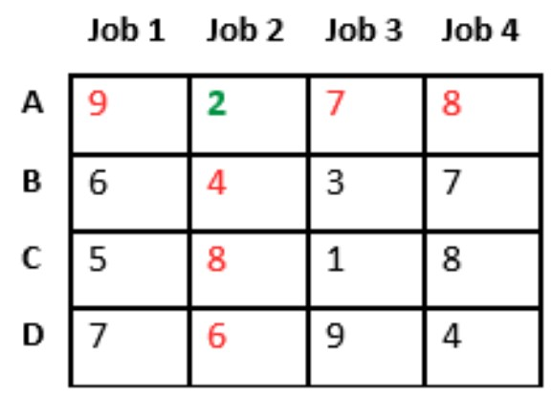
Discussion of Results
1.
2.

Slide 14
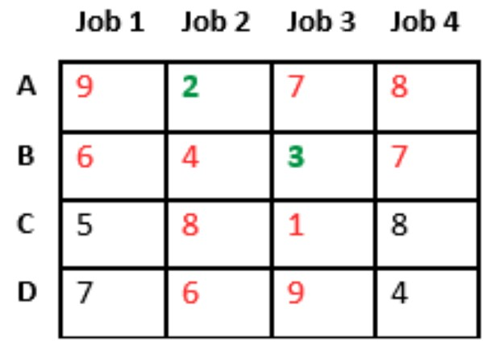
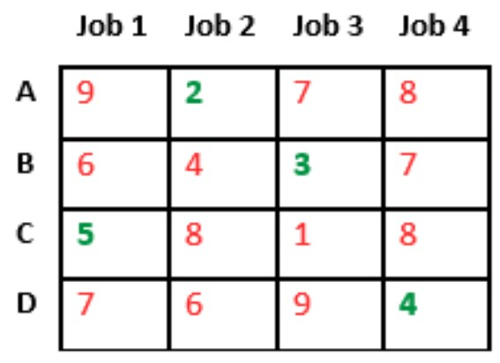
3.
4.

Slide 15
Time Complexity
Since the solution is a permutation of the n jobs, its complexity is
O(n!).
Since the solution is a permutation of the n jobs, its complexity is O(n!).

Slide 16
Applications
Assignment of operators to jobs.
Effectiveness of teachers and subjects.
Allocation of machines for optimum utilization of space.
Allocation of salesmen to different sales areas.
Applicability in various diverse business situations, we discuss some of its main application areas:
In assigning machines to factory orders.
In assigning sales/marketing people to sales territories.
In assigning contracts to bidders by systematic bid-evaluation.

Slide 17
THANK YOU

